Slide 1
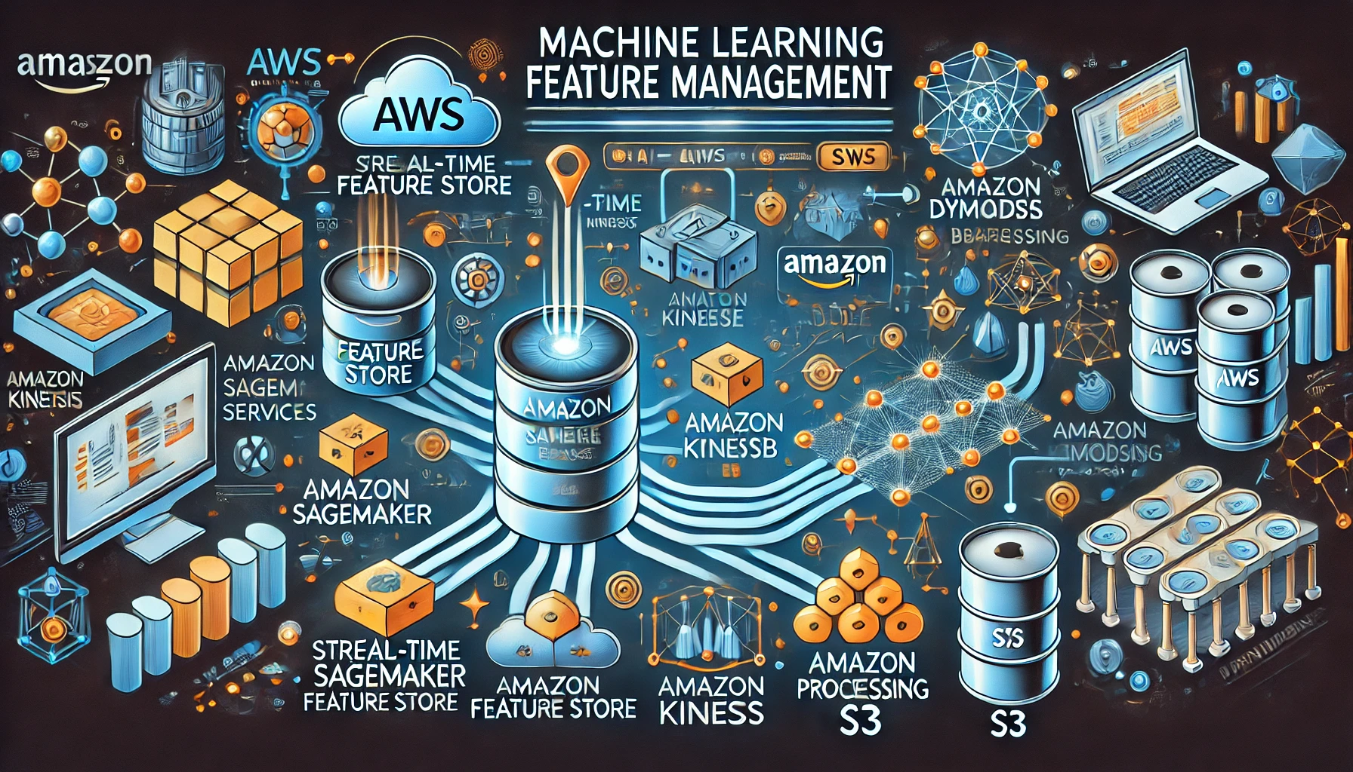
Building a Real-time Customer Feature Store with AWS SageMaker
A Case Study on Real-time Feature Management

Slide 2
Managing real-time feature ingestion and serving for ML models is complex
Traditional databases are not optimized for ML feature storage and retrieval
Ensuring feature consistency across training and inference is crucial.
Problem Statement

Slide 3
Features should be available in real-time for inference and in batches for training
A low-latency, scalable architecture is needed
AWS services like SageMaker Feature Store, DynamoDB, and S3 provide an efficient solution
In this simulation, real-time streaming is assumed without using Kinesis and Lambda
Analysis

Slide 4

SageMaker Feature store Implementation
Used AWS SageMaker Feature Store for feature management
Simulated real-time ingestion using batch updates
Stored batch features in Amazon S3 and real-time features in DynamoDB
Retrieved features seamlessly for model training and inference.

Slide 5
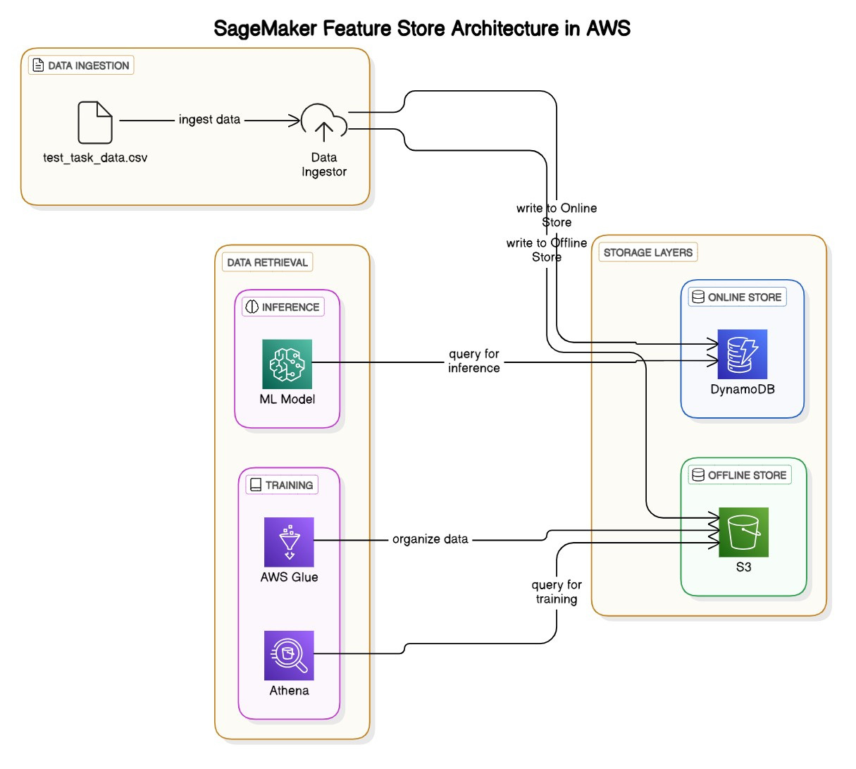

Slide 6
Ensures feature consistency across training and inference
Reduces latency for real time inference
Enables scalability and automation in feature management
Future proof solution that can integrate with additional AWS services as needed
Impact

Slide 7
Case study assumes Kinesis and Lambda as optional future enhancements to handle real time streaming features
Full privileged IAM policies like “AmazonS3FullAccess“ have been used. In real time, these policies can be more fine grained
Historical features between the period of Jan 1, 2022 and Aug 31, 2022 were pulled from the offline store to train a model
Assumptions

Slide 8
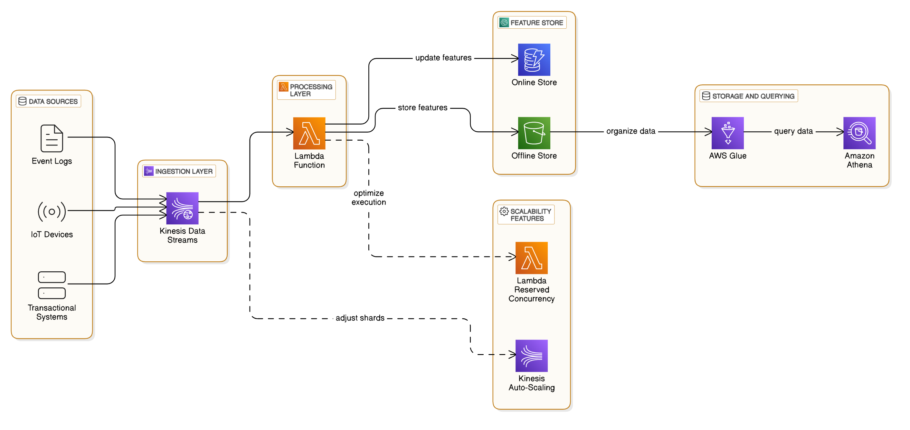
Scaling strategy
Amazon Kinesis ingests millions of feature updates in real-time. Enable Auto-Scaling & Partitioning
AWS Lambda processes Kinesis events and updates SageMaker Feature Store. Use Reserved Concurrency & Batch Processing
SageMaker Feature Store Online Store (DynamoDB) provides low-latency feature retrieval for inference. Switch to On-Demand Mode
SageMaker Feature Store Offline Store (S3) stores historical feature data for training. Use Parquet Format & Intelligent Tiering
AWS Glue & Athena enable batch feature retrieval for ML model training
Auto-scaling mechanisms ensure efficient handling of high-velocity updates

Slide 9
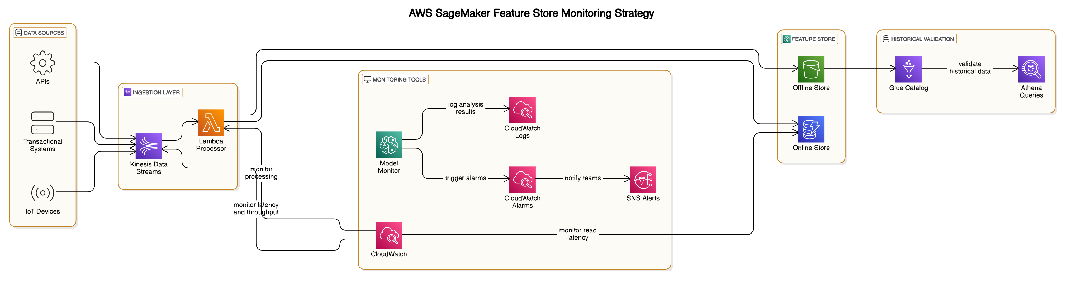
Monitoring strategy
Feature Ingestion & Latency Monitoring
Track latency via CloudWatch (PutRecord.latency)
Monitor update throughput using Kinesis (IncomingRecords)
Set CloudWatch Alarms for delays & trigger SNS alert
Feature Quality & Data Drift Monitoring
Compare real-time vs. baseline distributions using AWS Model Monitor
Detect feature drift, missing values & data quality issues
Lambda + CloudWatch logs for anomaly detection
Query performance and System availability
Monitor DynamoDB latency & query performance
Track S3 object growth for historical storage integrity
AWS Lambda for issue logging & SNS notifications
Historical feature data monitoring for Model training
Query historical features via Athena+Glue for consistency
Detect missing/inconsistent features in offline S3
Use automated SQL queries to validate future trends

Slide 10
Cost Approximation for feature store implementation
1. Feature store Storage and Access costs (monthly)
Service | Usage Estimate | Cost Estimate $ | Notes
Amazon Sagemaker Feature store | 1TB of online storage | $ 250 | $0.25 per GB per month for online store
 | 10 TB of offline storage | $ 230 | $0.023 per GB per month (S3 Standard)
Dynamo DB (Online Store Backend) | 500K reads/sec , 50K writes/sec | $ 2500 | On demand pricing based on usage
Amazon S3 (offline store) | 10 TB storage | $ 230 | Data lake for historical features
2. Feature Ingestion & Processing Costs (monthly)
Service | Usage Estimate | Cost Estimate ($) | Notes
Kinesis (Stream ingestion) | 10 shards , 100 TPS | $ 1000 | Data stream for real time ingestion
AWS Glue (ETL for offline store) | 30 DPUs, 2 hrs/day | $ 900 | Data prep and transformation
AWS Lambda (ETL & Feature Transformations) |  | $ 300 | Serverless processing for data cleaning
3. Model & Feature Quality Monitoring (monthly)
Service | Usage Estimate | Cost Estimate ($) | Notes
Model Monitor (Data drift detection) | 50 monitoring jobs/ day | $ 1500 | SageMaker Model Monitor runs jobs to detect data drift
CloudWatch Logs & Alarms | 100 GB logs/month | $ 200 | Logging and alerting for feature drift, ingestion latency
AWS Lambda (Anomaly Detection & Alerts) | 500K executions | $ 250 | Serverless anomaly detection

Slide 11
Cost Approximation for feature store implementation (contd.)
4. Query performance & System Availability (monthly)
Service | Usage Estimate | Cost Estimate $ | Notes
DynamoDB (Real-time Query Performance Monitoring) | 250K read ops/sec | $ 2000 | On-demand query performance tracking
AWS Lambda (Query Logging & Analysis) | 500K invocations | $ 250 | Logs query failures, response times
Amazon S3 (Historical Data Retention) | 10 TB storage | $ 230 | Data lake for historical features
5. Miscellaneous & Overhead (monthly)
Service | Usage Estimate | Cost Estimate ($) | Notes
Athena (Historical feature queries) | 500 queries /day | $ 400 | Querying historical features for model retraining
SageMaker Training & Deployment | 1 instance (ml.m5.4xlarge) | $ 800 | Model training on feature store data
IAM & Data Transfer | 100TB transfer out | $ 300 | Costs for cross-region data movement
Source: AWS Pricing Calculator
Cost Optimization strategies
Use reserved instances for Sagemaker and Dynamo DB
Optimize feature store queries: Use batch retrieval instead of on demand requests
Tiered Storage (Glacier for Long-Term Data) – Move old data from S3 Standard to S3 Glacier to cut costs
Use Lambda Efficiently – Minimize invocation frequency for data drift detection.

Slide 12
S
Thank You

